Slide 1
Performance
Test DB with Jmeter

Slide 2
Installation
Copy Jmeter from N:\SD-Sharing\QC\Jmeter
to local machine

Slide 3
Jmeter - Start
1. Go to apache-jmeter-2.13\bin
2. Open jmeter.bat

Slide 4
Jmeter - Add Threads
1. Right click Test Plan -> Add -> Threads(Users) -> Thread Group
2. Set Number of Threads (users) : 100
3. Loop Count : 5
(noted uncheck checkbox Forever)

Slide 5
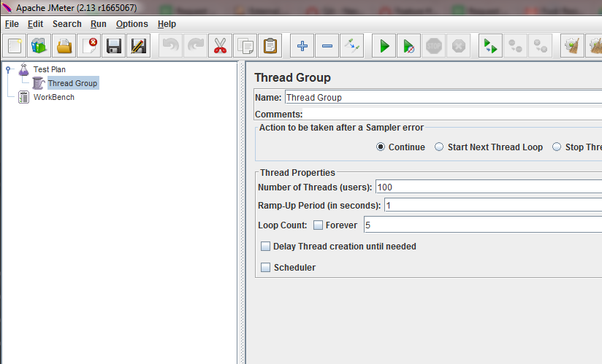

Slide 6
JDBC Connection config (SQL Server)
1. Right click Thread Group -> Add -> Config
Element -> JDBC Connection Configuration
2. Set Variable Name : StressTest
3. Database URL : jdbc:sqlserver://IP SQL Server:port;intancename=intancename;DatabaseName=DatabaseName
Exp: jdbc:sqlserver://10.18.200.215:1433;intancename=MSSQLSERVER;DatabaseName=bodb_age
4. JDBC Driver class = com.microsoft.sqlserver.jdbc.SQLServerDriver
5. Username and password login to sQL Server

Slide 7
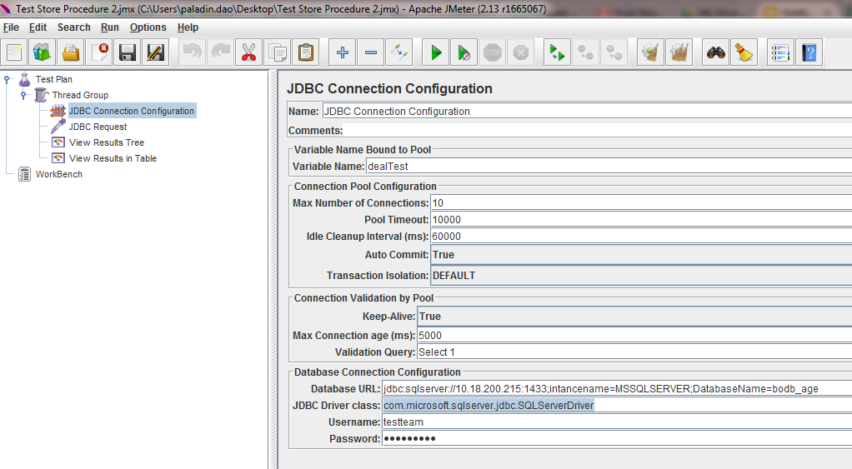

Slide 8
JDBC Connection config (MySQL)
1. Right click Thread Group -> Add -> Config
Element -> JDBC Connection Configuration
2. Set Variable Name : StressTest
3. Database URL : jdbc:mysql://IP SQL Server:port;intancename=intancename;DatabaseName=DatabaseName
Exp: jdbc:mysql://10.18.200.70:3307/DCS_DataCenter
4. JDBC Driver class = com.mysql.jdbc.Driver
5. Username and password login to MySQL

Slide 9
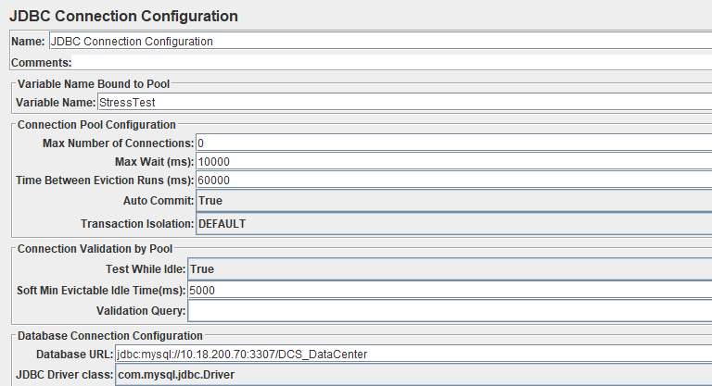

Slide 10
Jmeter - Add JDBC Request
1. Right click Thread Group -> Add -> Sampler -> JDBC Request.
2. Set Variable Name : StressTest
3. Input Query need to be tested.

Slide 11
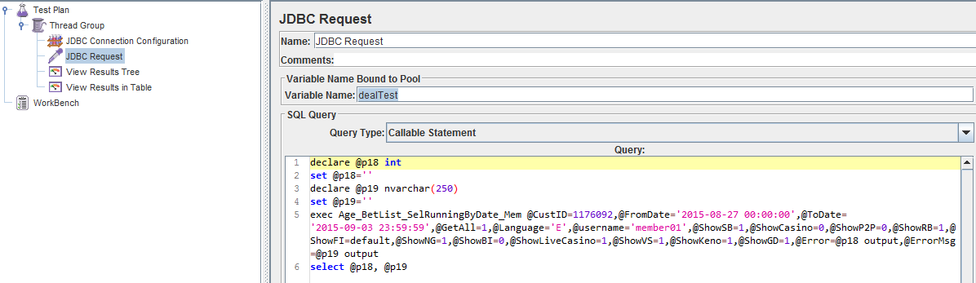
Jmeter - Add JDBC Request

Slide 12
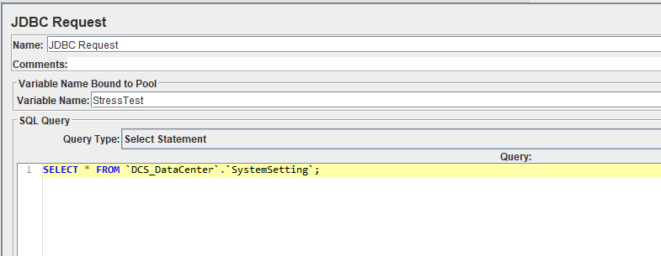
Jmeter - Add JDBC Request (MysQL)

Slide 13
Jmeter - Add Listener
1. Right click Add -> Listener -> View Results in Table
2. Add more Listener if needed.

Slide 14
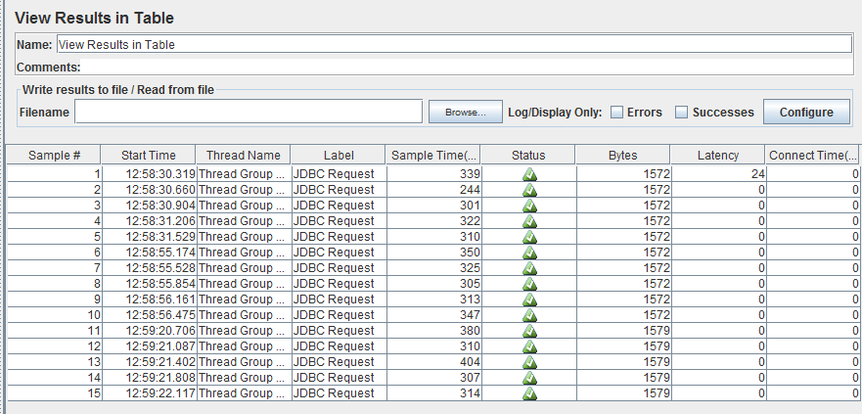
Jmeter - View Result
Run and view result

